Slide 1
Tracking Dependencies
Regardless of which method is used to identify invalidations, both the database and the developers must know which objects are involved in dependencies.
 This makes it even more important for the developer to track dependencies.

Slide 2
Multi-Level Dependencies
We already know that when any dependent object changes, then the procedure or function associated to it is marked invalid and will require revalidation and compilation.
Many times, this will work.
However, revalidation may fail which requires the work of a developer.

Slide 3
Multi-Level Dependencies (cont)
Our primary concern is with Multi-Level Dependencies.
As a database grows to include hundreds (or more) stored program units, tables, views, etc., the possibility of a single change affecting multiple objects is practically guaranteed.
Imagine how a change to the EMPLOYEE table within our database could affect a production application

Slide 4


Multi-Level Dependencies (cont)
raise_salary()
Procedure
fetch_salary()
Function
EMPLOYEE
Table
salary_valid()
Function
Dependent on the EMPLOYEE table
Dependent on the fetch_salary() Function

Slide 5
The Dependency Tracking Utility
While the USER_DEPENDENCIES table shows one level of dependency, the dependency tracking utility will recursively reflect all dependencies.
Works with objects that are directly dependent upon one level of objects.
Creates a dependency tree if an object is indirectly dependent upon other objects, through multiple levels
It is your choice when you wish to use the dependency tracking utility.

Slide 6
Dependency Tracking Utility Setup
The Dependency Tracking Utility is a stored procedure. One that must be created within the schema before use.
It is a system-supplied script
It is named UtlDTree.SQL
Found in the Database Administrator Directory on the server
The exact location will be installation and version-dependent

Slide 7
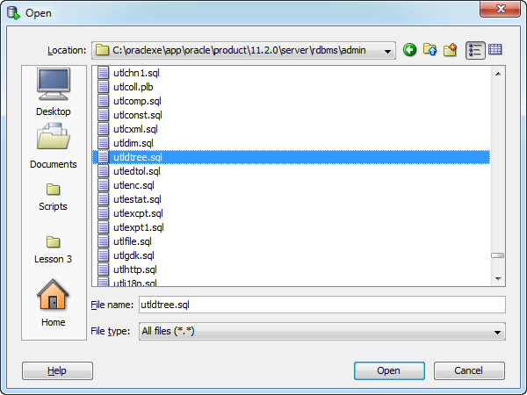
Dependency Tracking Utility Setup
The path on this system is:
c:\oraclexe\app\oracle\product\11.2.0\server\rdbms\admin

Slide 8
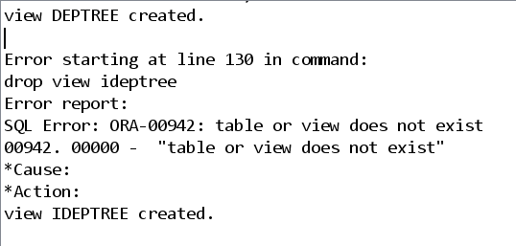
Dependency Tracking Utility Setup
It’s normal for this script to report some errors.

Slide 9

See It In Action

